Slide 1
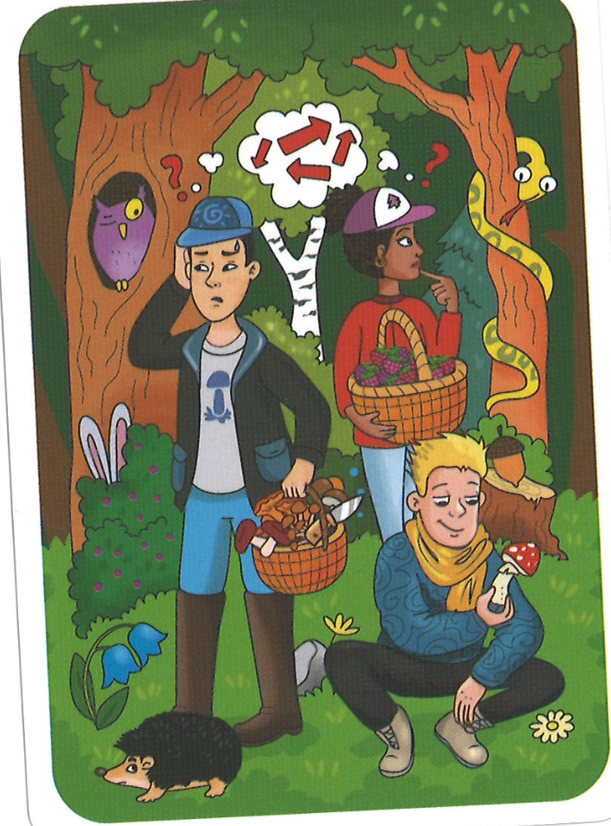
What do we know how to say?:
What do we see What can we infer?
Action words:
Image from: OKstorycards.com

Slide 2
What can we substitute or rephrase?
  Forest:
  Mushroom:
Lost:
What details can we make up?
Biographical
Why/What’s next:
What do we absolutely need to look up?
Hay
there is
Es
is
Tiene
has
Quiere
wants
Está
Is (feeling/location)
Va
goes
Le gusta...
he/she likes…
Image from: OKstorycards.com

Slide 3
My paragraph:
High FrequencyWords:
Hay – There is
es – is (description)
está – is (location/feeling)
Tiene – has
Quiere – wants
Va – goes
Ve – sees
Puede - can
Le gusta - likes
Busca – looks for
Da – gives
Sabe – knows
Sale – leaves
Hace – makes
Dice – says
Pone – puts
Set the scene: What’s there? Where is it? What is happening/What are they doing? Why? What’s going to happen next?
_________________________________
_________________________________
_________________________________
_________________________________
_________________________________
_________________________________
_________________________________
_________________________________
_________________________________
_________________________________
Image from: OKstorycards.com

Slide 4
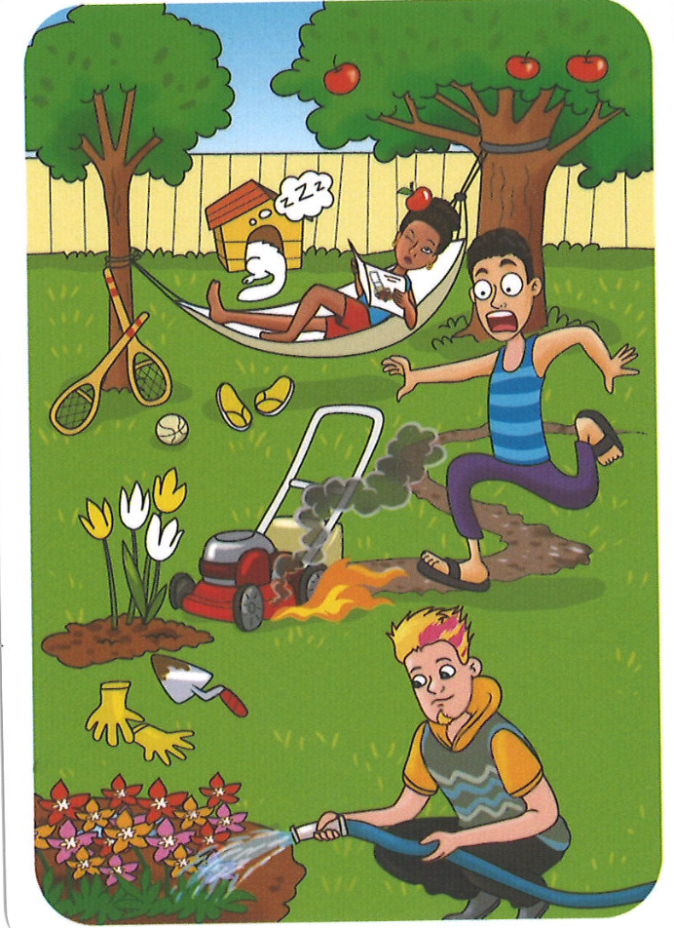
People:
Place:
Feelings:
Actions:
Image from: OKstorycards.com

Slide 5
Let’s write together:
Image from: OKstorycards.com

Slide 6
Co-written example. See slides notes for information.
Hay tres personas. Están en la parte atrás de la casa donde hay arboles. Hay una mujer que está descansando y leyendo. Una manzana del árbol ahora está en su cabeza. ¡Ouch! Le duele. También hay un hombre corriendo. Cuando corta las plantas hay un problema. La cosa que corta está muy caliente. Él está nervioso porque va a cortar las flores bonitas. Hay otro hombre que tiene pelo raro porque es rubio con partes rojas. Pone agua en las flores.
Image from: OKstorycards.com
Notes:
Start with the word “HAY” to set the scene. Introduce the people. Here we introduced the 3 people one by one and said what each one was doing. We had to use simple language to express the situations. Instead of ”the girl gets hit on the head by a falling apple” we can say that NOW there is an apple on her head and use a word like OUCH to indict that it fell without having to say that. We can describe a lawnmower as a “thing that cuts” and talk about that things aren’t write by saying there is a problem and instead of “it’s one fire” we can say it is very hot. We introduced the 3rd person by physically describing him with some adjectives and talking about his hair. We replaced the word “watering flowers” with a simple “puts water on the flowers” or even “gives water to the plants”.

