Slide 1
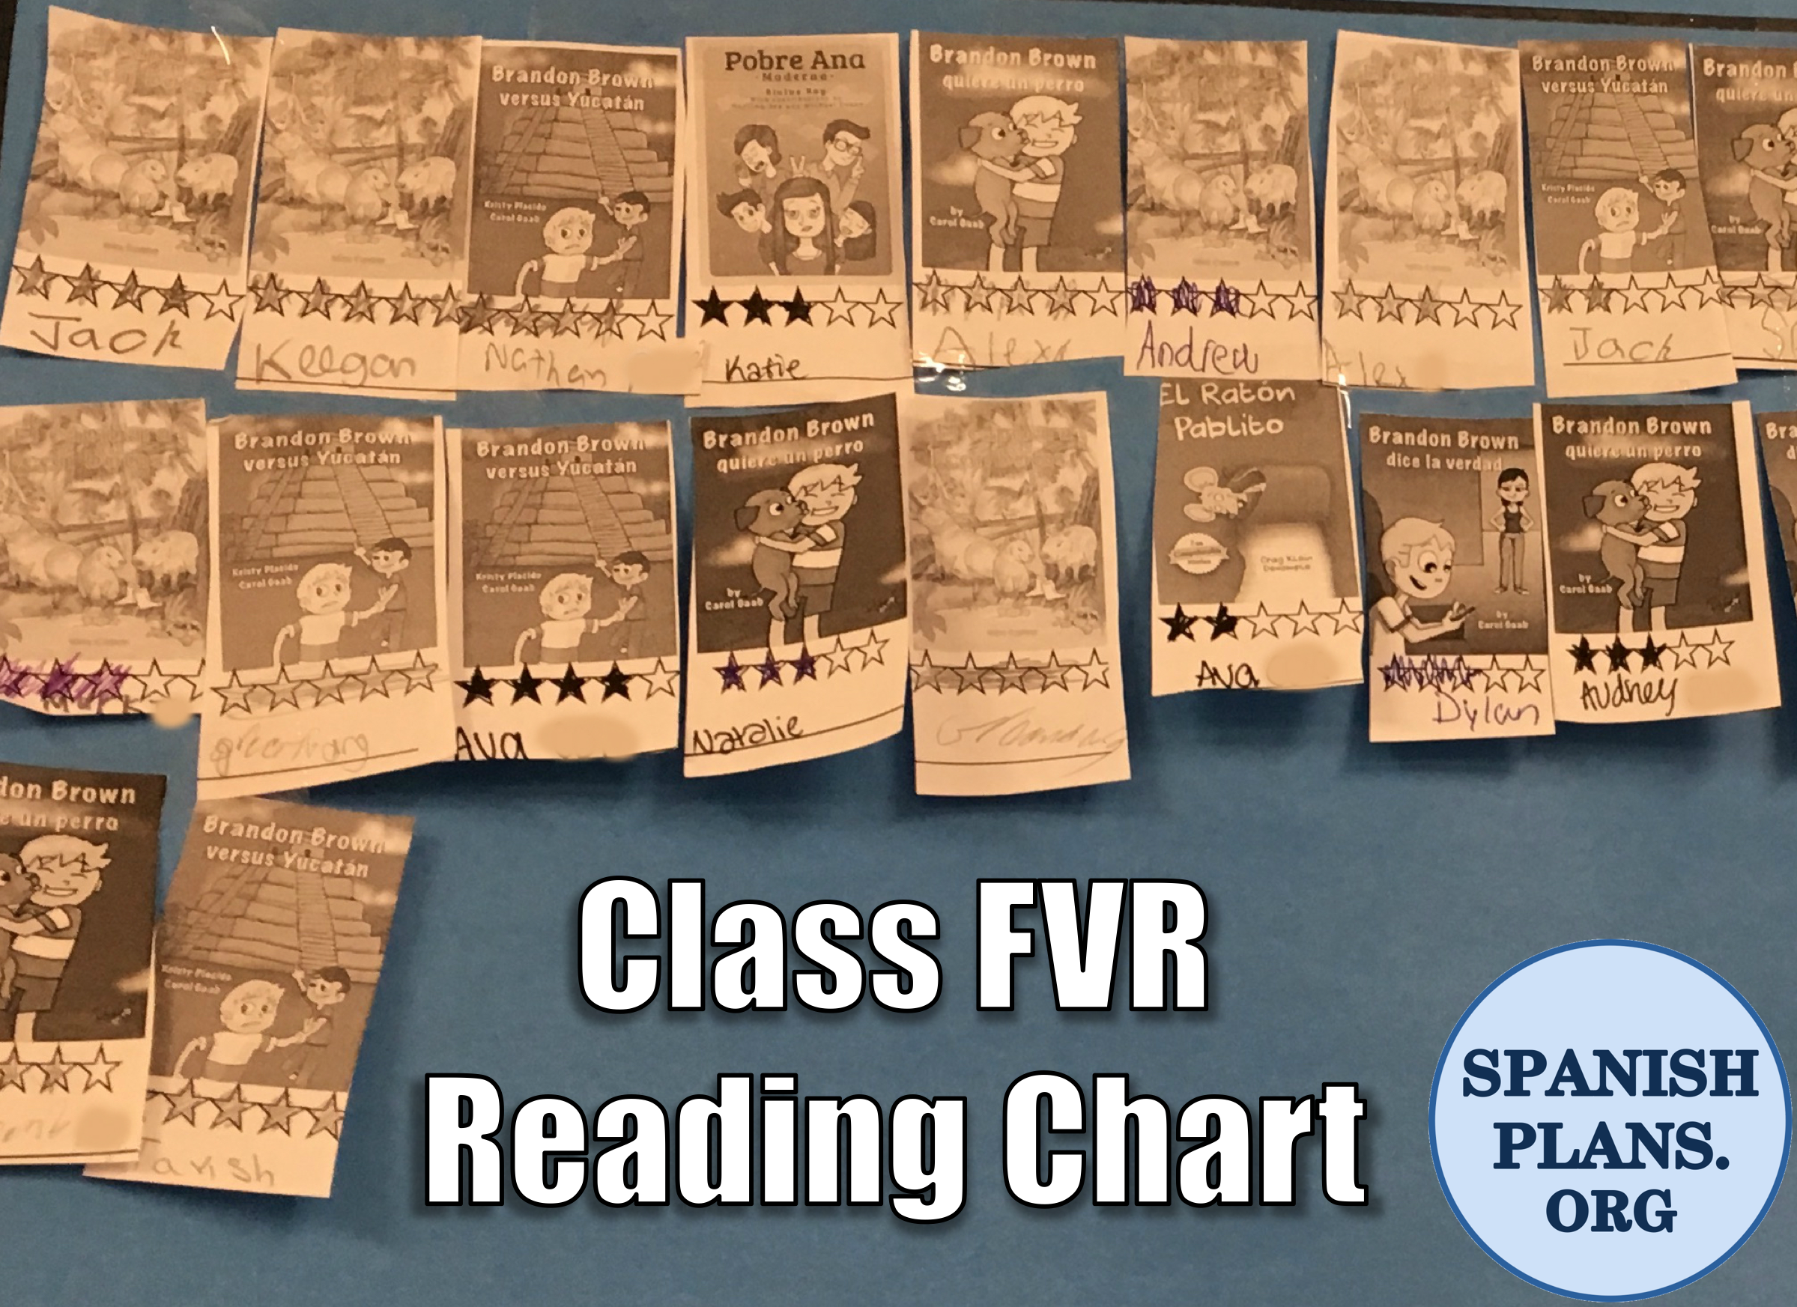
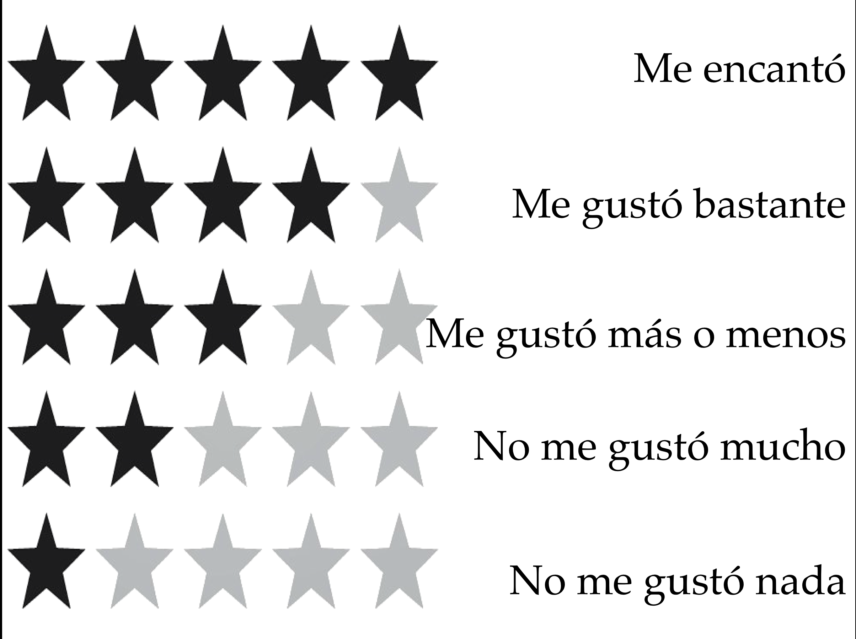





Connect with Us
www.SpanishPlans.org
www.SpanishTeacherShop.com
@SpanishPlans
Read the Blog Post at:
http://spanishplans.org/2017/12/04/fvr-accountability/

Slide 2

__________________________________________________________
__________________________________________________________
__________________________________________________________
__________________________________________________________

Slide 3

__________________________________________________________________________________________
__________________________________________________________________________________________
__________________________________________________________________________________________
__________________________________________________________________________________________

Slide 4

______________________________________________________________________
______________________________________________________________________
______________________________________________________________________
______________________________________________________________________

Slide 5

__________________________________________________________________________________________
__________________________________________________________________________________________
__________________________________________________________________________________________
__________________________________________________________________________________________
__________________________________________________________________________________________

Slide 6

__________________________________________________________________________________________
__________________________________________________________________________________________
__________________________________________________________________________________________
__________________________________________________________________________________________
__________________________________________________________________________________________

Slide 7

__________________________________________________________________________________________
__________________________________________________________________________________________
__________________________________________________________________________________________
__________________________________________________________________________________________
__________________________________________________________________________________________
__________________________________________________________________________________________

Slide 8

__________________________________________________________________________________________
__________________________________________________________________________________________
__________________________________________________________________________________________
__________________________________________________________________________________________

Slide 9

__________________________________________________________________________________________
__________________________________________________________________________________________
__________________________________________________________________________________________
__________________________________________________________________________________________
__________________________________________________________________________________________

Slide 10

__________________________________________________________________________________________
__________________________________________________________________________________________
__________________________________________________________________________________________
__________________________________________________________________________________________
__________________________________________________________________________________________
__________________________________________________________________________________________
__________________________________________________________________________________________
__________________________________________________________________________________________

Slide 11

__________________________________________________________________________________________
__________________________________________________________________________________________
__________________________________________________________________________________________
__________________________________________________________________________________________

Slide 12

__________________________________________________________________________________________
__________________________________________________________________________________________
__________________________________________________________________________________________
__________________________________________________________________________________________
__________________________________________________________________________________________
__________________________________________________________________________________________
__________________________________________________________________________________________

Slide 13

__________________________________________________________________________________________
__________________________________________________________________________________________
__________________________________________________________________________________________
__________________________________________________________________________________________

Slide 14

__________________________________________________________________________________________
__________________________________________________________________________________________
__________________________________________________________________________________________

Slide 15

__________________________________________________________________________________________
__________________________________________________________________________________________
__________________________________________________________________________________________
__________________________________________________________________________________________

Slide 16

__________________________________________________________________________________________
__________________________________________________________________________________________
__________________________________________________________________________________________
__________________________________________________________________________________________

