Slide 1
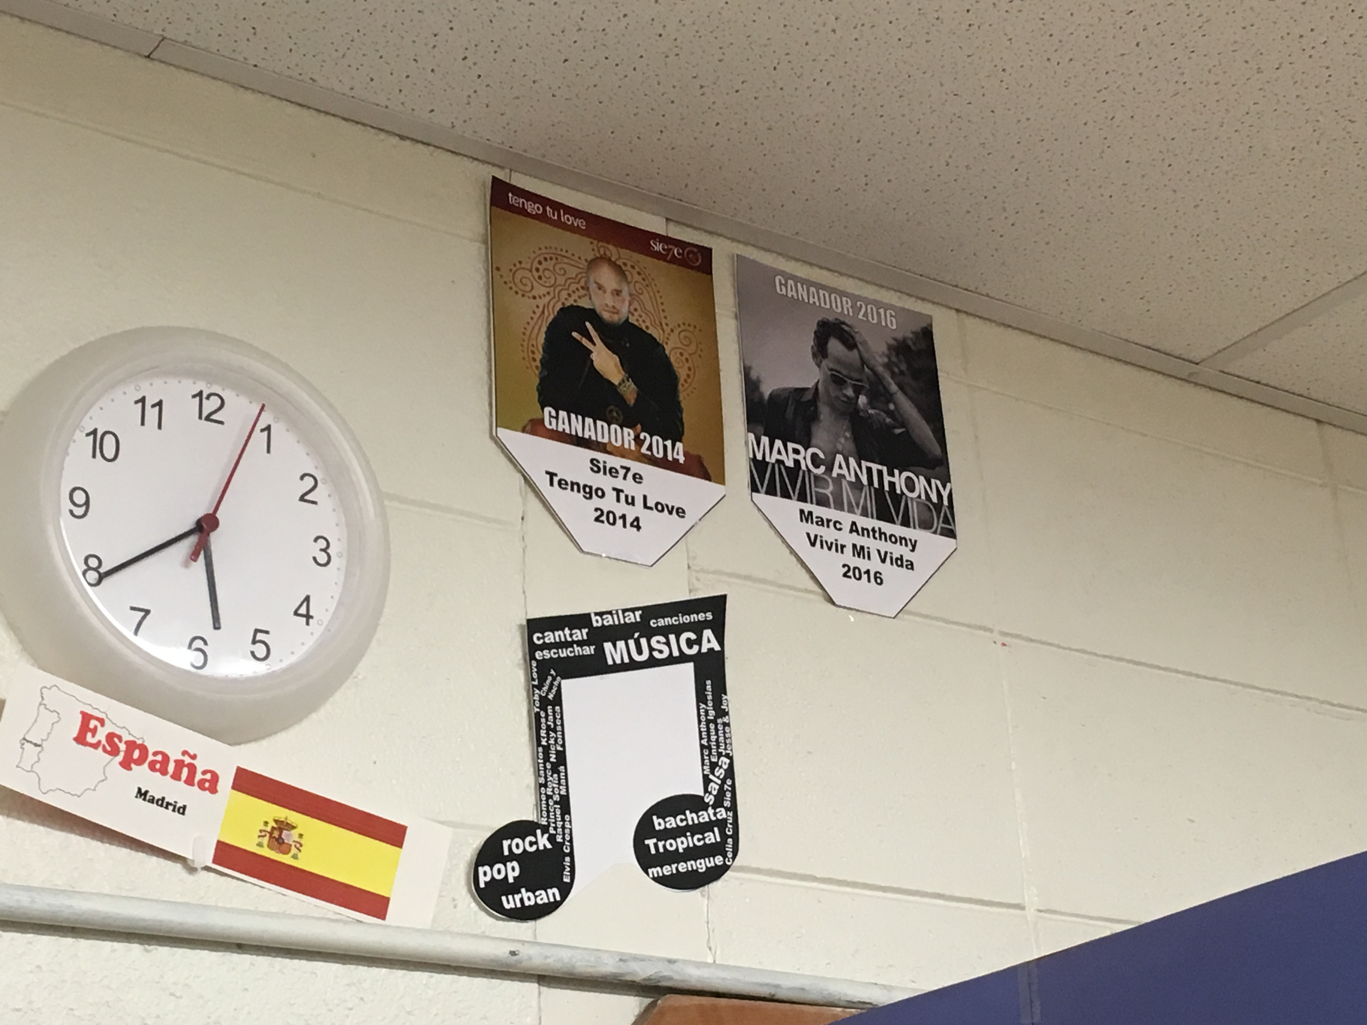
March Madness Winner Champion Pennant
1. Insert (or drag) a photo in the slideshow. Right click, select “arrange” and select “Send to Back”. You can edit and move the text that says “Ganador 2016”.
2. Edit the bottom text with name of artist, song, and year.
3. Print, Cut Out, Hang up in classroom.

Slide 2



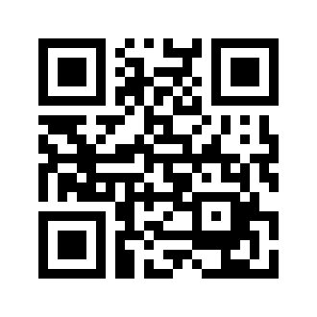



Connect with Us
www.SpanishPlans.org
www.SpanishTeacherShop.com
www.facebook.com/SpanishPlans
www.pinterest.com/SpanishPlans
www.instagram.com/SpanishPlans
www.instagram.com/SpanishWorld1
www.twitter.com/SpanishPlans
Get our all social media links
www.SpanishPlans.org/connect
https://www.teacherspayteachers.com/Store/Spanishplans
Permissions: You may make as many hard copies of this document for your classroom or personal use. You may not share this item with your team, department or colleagues, either digitally or making copies for them.
You may post pictures of your students using this item on any social media.
You may not post this document online or make it available digitally.
This Product Created by SpanishPlans. All Rights Reserved. ©2016

Slide 3

GANADOR 2016
Marc Anthony
Vivir Mi Vida
2016

Slide 4

GANADOR 2016
GANADOR 2014
Sie7e
Tengo Tu Love
2014

