Slide 1


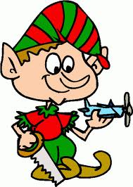
In your letter:
Introduce yourself (who you are, how old, where you live)
State how you have behaved (give examples of any behaviors/characteristics)
  Me he portado (muy) bien/mal
State what you want and why and what you do not want
Quiero = I want necesito = I need
Me gustaría = I would like Tengo = I have nuevo = new
State what other people in your family want/need/would like and how they have behaved
    Se ha portado bien/mal….
    Quiere…
    (A _____ ) le gustaría
Where your Christmas tree is (what room in your house)
and where he CAN PUT the gifts.
Words: gift= regalo
tree = árbol de navidad
Christmas day= día de Navidad
Christmas Eve = La Nochebuena
Hanukkah = Januká, Hanukkah
give = dar

